Slide 1





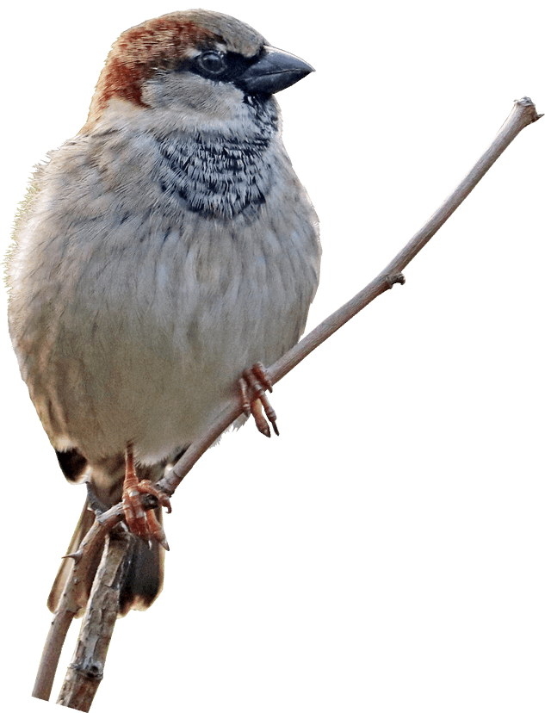
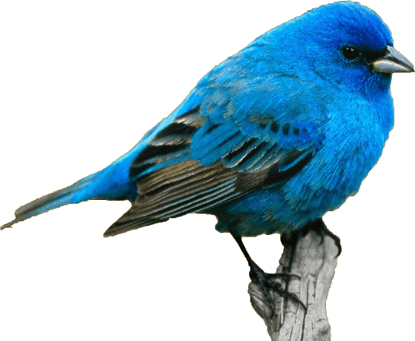
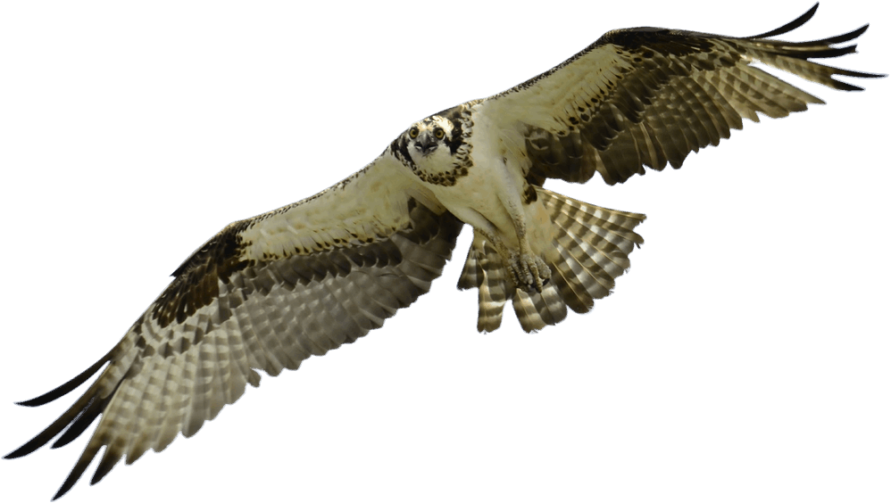
EasyLearners
EcoEye
Monitoring the Bird Species

Slide 2





Table of Contents
​
Introduction
Climate Effect
Features
Who can benefit
How it works
Reasons to choose
Pricing
Call to Action
Future Enhancement
Our Team
Thank You
​

Slide 3


Introduction
Eco Eye is a ground breaking technology company that offers advanced bird species monitoring system with the help of AI.
Our solutions Help you track, monitor, and analyze bird species to protect their habitats and protect biodiversity.

Slide 4


Climate Effect
Climate Change has significantly impacted bird population and contributed to species decline and extinction.
For Example: rising temperature alter habitat suitability, affected breeding, nesting, and migration patterns.

Slide 5
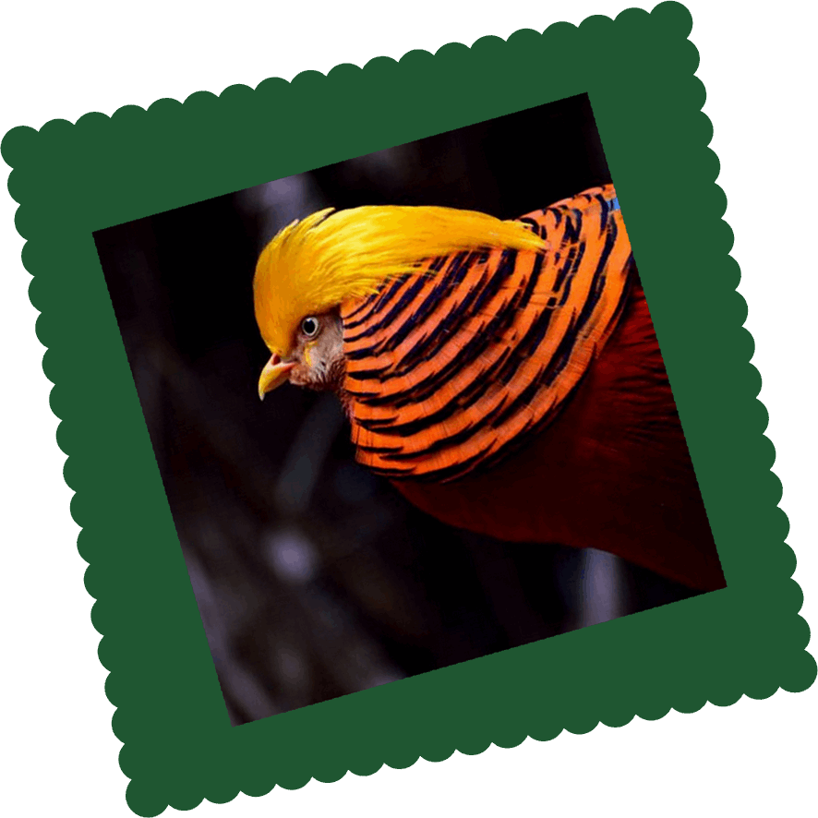


Features
01
Acurate Bird Identification.
02
Acurate Migration Tracking.
03
Real-Time Prediction.
04
Real-Time Data Collection.
05
User-Friendly Interface.

Slide 6





Who can benefit ?
Researchers
Students
Birdwatchers
Conservationists

Slide 7

How it Works ?
User Uploads an Image of a bird.
Eco Eye’s model analyzes key features using OpenCV.
Predicts the species of the bird with high accuracy .
Provides instant results to the user.
Let's see it in next slide!

Slide 8
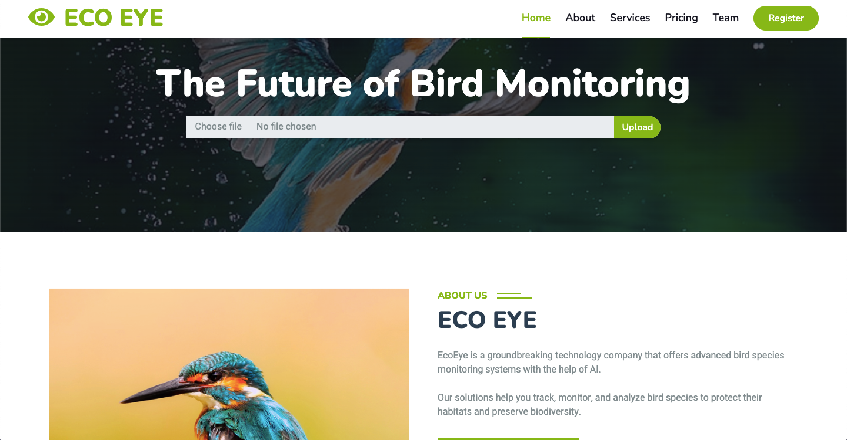
Link: https://ecoeye-onlinebirdmonitoringsystem-7voh.zeet-technovishalgir.zeet.app/

Slide 9
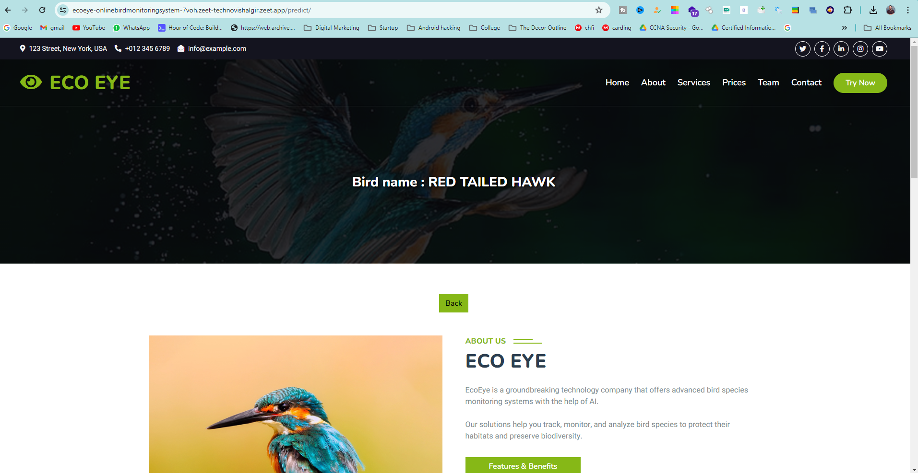
Link: https://ecoeye-onlinebirdmonitoringsystem-7voh.zeet-technovishalgir.zeet.app/

Slide 10
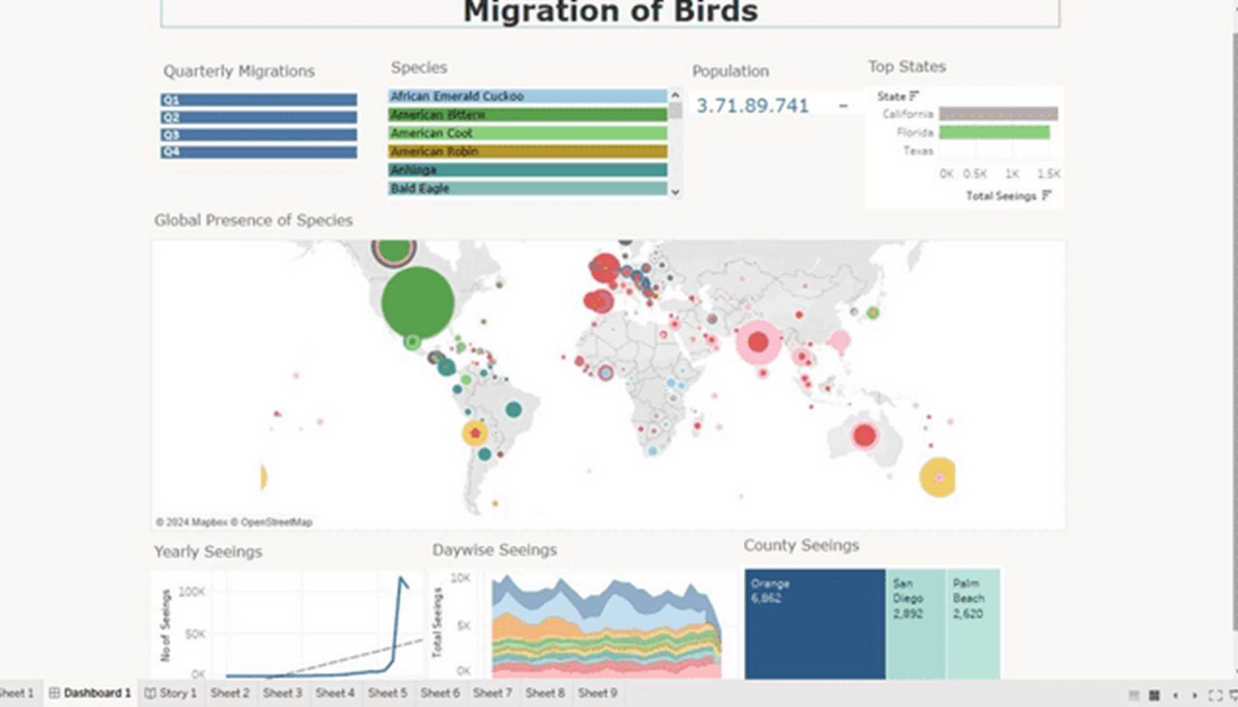
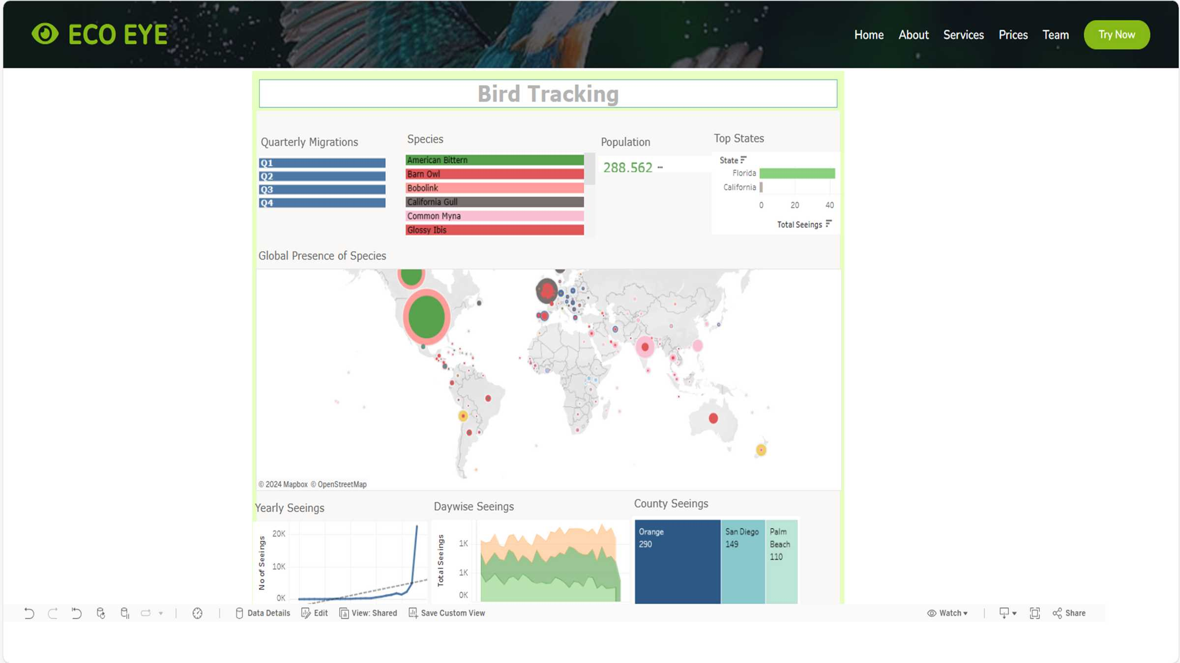

Slide 11
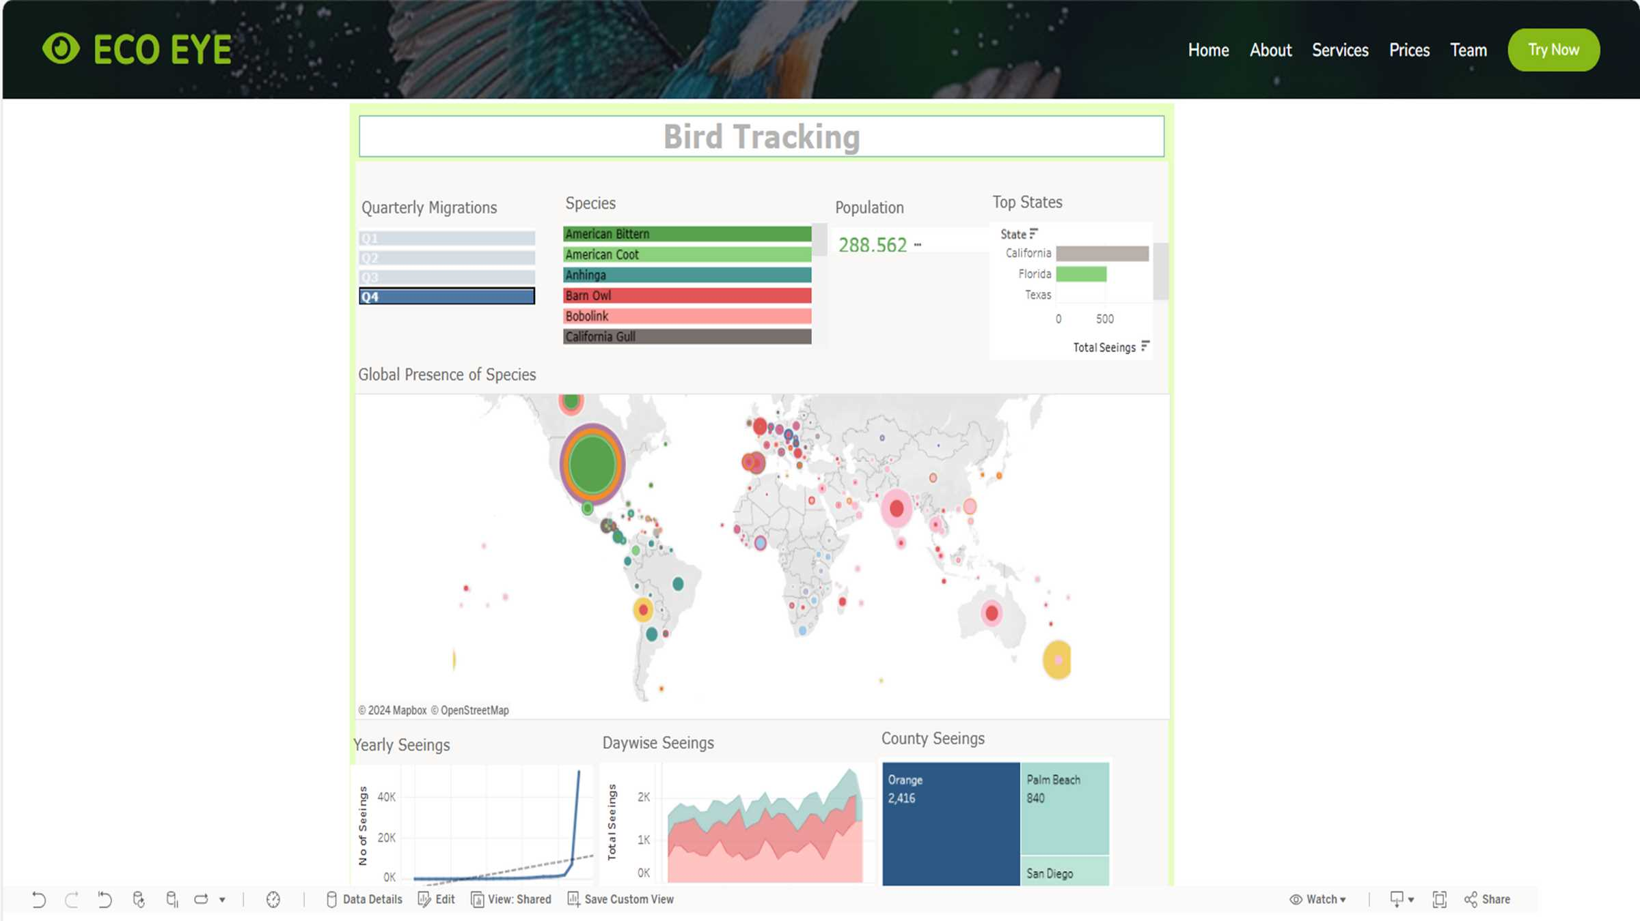
Only For Loyalist College Members,
Free For One Year.

Slide 12
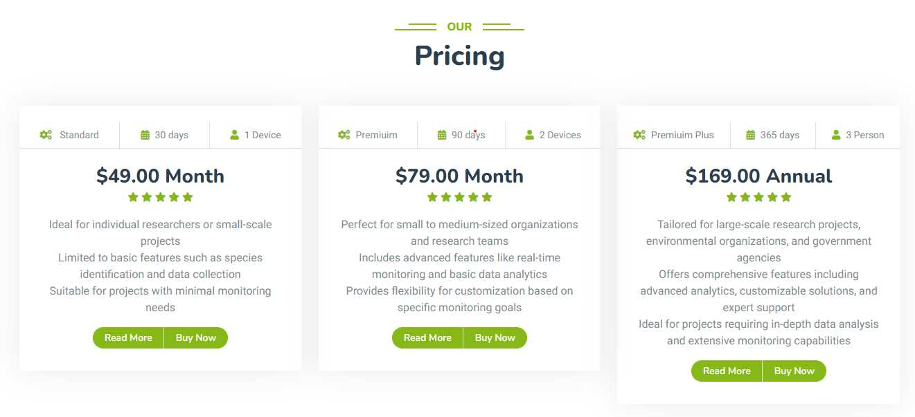
Only For Loyalist College Members,
Free For One Year.

Slide 13
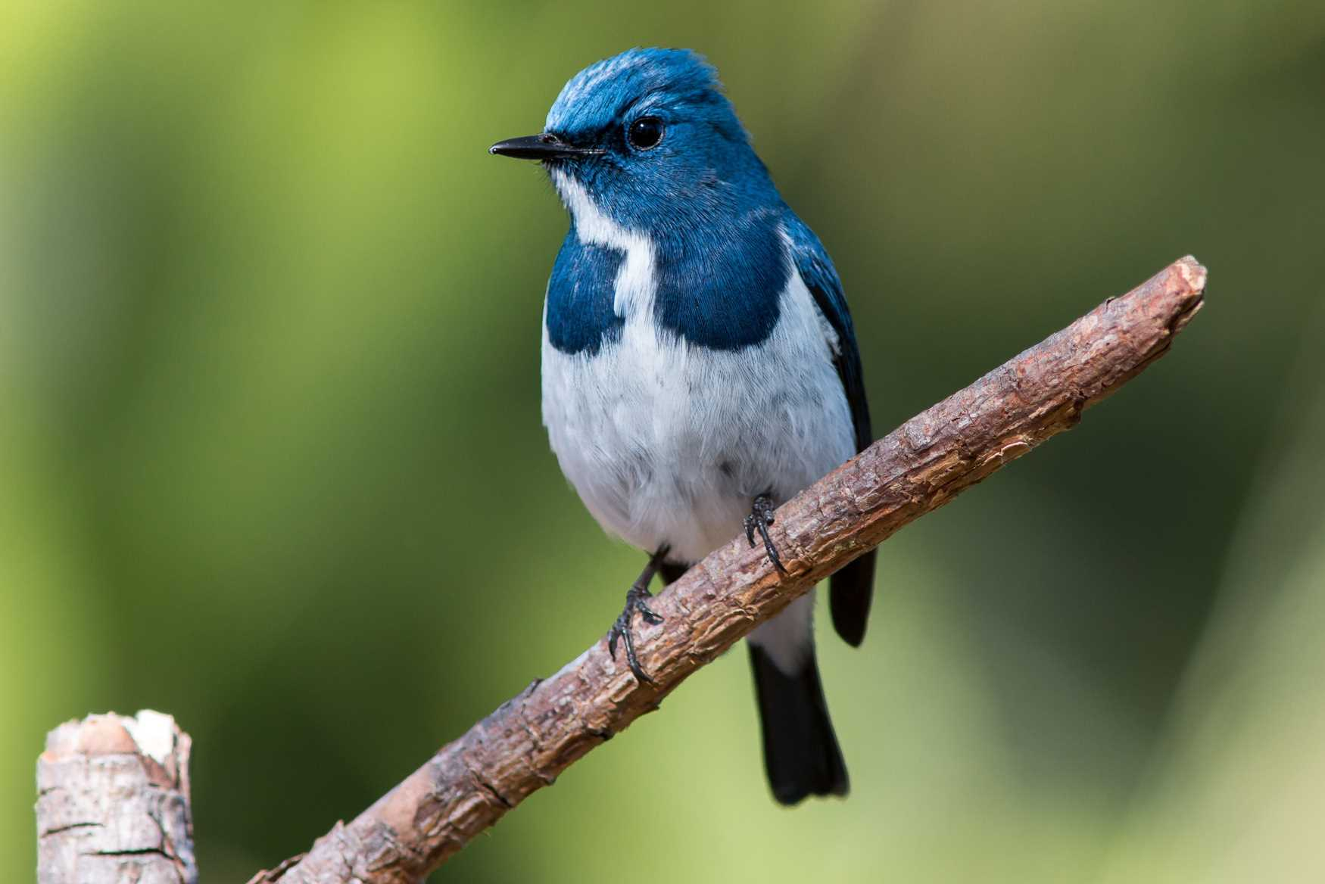
Why our Solution
Time-Saving: Instant identification without manual research.
Accuracy: Reliable predictions based on robust algorithms.
Accessibility: Available anytime, anywhere through our platform.
Educational: Enhance understanding and appreciation of birds.

Slide 14



Call to Action
Get Started With Eco Eye Today!
Visit our Website to experience the power of bird recognization.
Scan the QR code and provide us your valueable feedback ,
Join our community of bird enthusiasts.
Dashboard
Creation and
Stress Testing

Slide 15
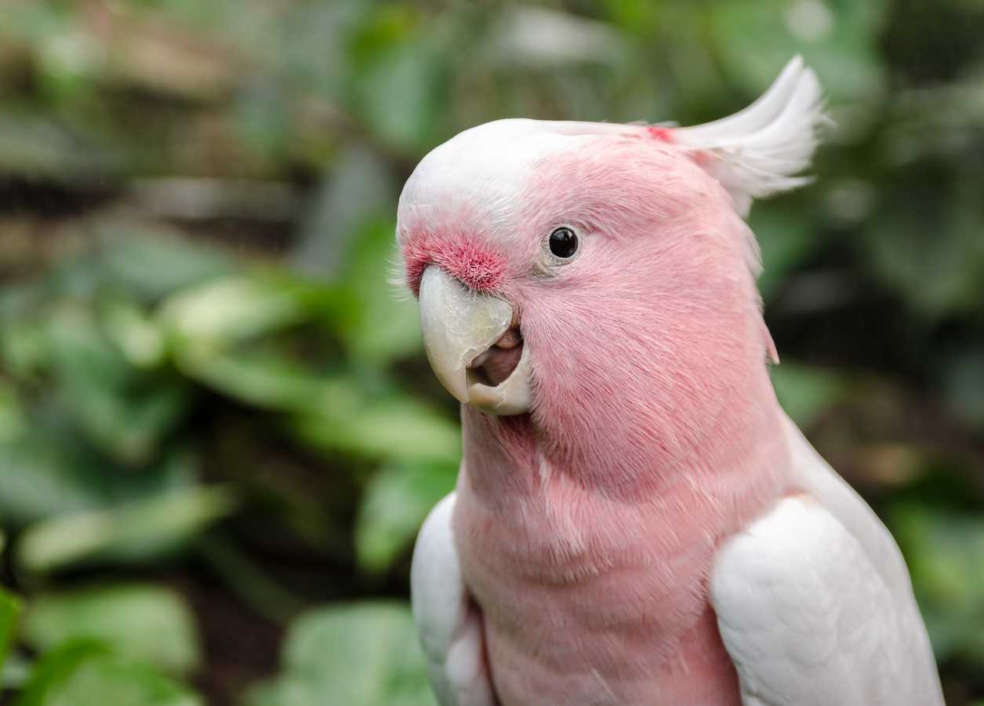

Future Developments
Continuous Improvement : Refining
algorithms for even better accuracy.
01
Mobile App Integration: Access
Eco Eye on the go.
02
Community Engagement: Partnering
with birdwatching groups for
feedback and data sharing.
03

Slide 16
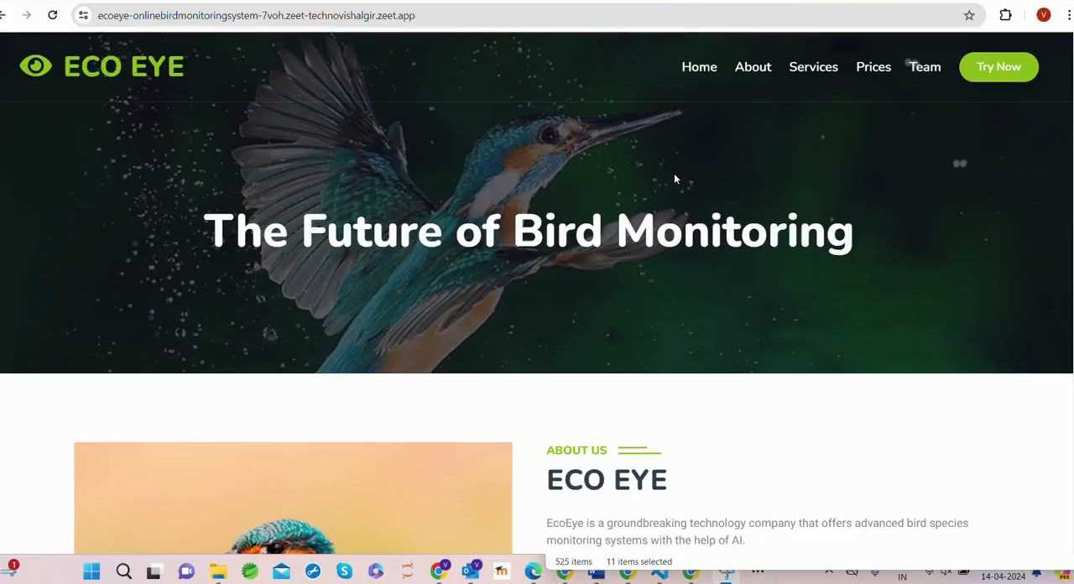

Slide 17

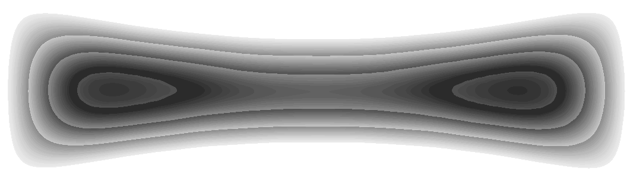


EcoEye
Thank You!
Bird by Bird, Track the Changes.

Slide 18
References:
Nigenda, D., Karnin, Z., Zafar, B., Ramesha, R., Tan, A., Donini, M., & Kenthapadi, K. (2022). Amazon SageMaker model monitor: A system for real-time insights into deployed machine learning models. KDD 2022. Link
Amazon Web Services, Inc. (2024). Machine learning inference - Amazon SageMaker model deployment. AWS. https://aws.amazon.com/sagemaker/deploy/

